Slide 1

CAKE
https://cakebuild.net

Slide 2
Who am I?

Slide 3

The problem
“Works on my machine!”
“Works on CI server!”
“Builds? That’s Bob’s job!”

Slide 4
Dependency based programming
Define tasks as discrete unit of work
Order is decided by dependencies
First introduced in Make (1976)
Nmake, Rake, MSBuild, NAnt, Psake, FAKE, Cake, Bau, Nuke…

Slide 5
Dependency based programming
Clean
Unit Tests
Static Analysis
Packaging
Build
Deploy
Calculate
Version

Slide 6
Dependency based programming
Clean
Calculate
Version
Build
Static Analysis
Build Server
Default
Unit Tests
Packaging
Deploy

Slide 7
Alternatives
Deploy by hand
Low bus factor
Risky
Not possible to automate

Slide 8
Alternatives
Scripts
Difficult to maintain
Easily becomes spaghetti
Often not cross platform

Slide 9
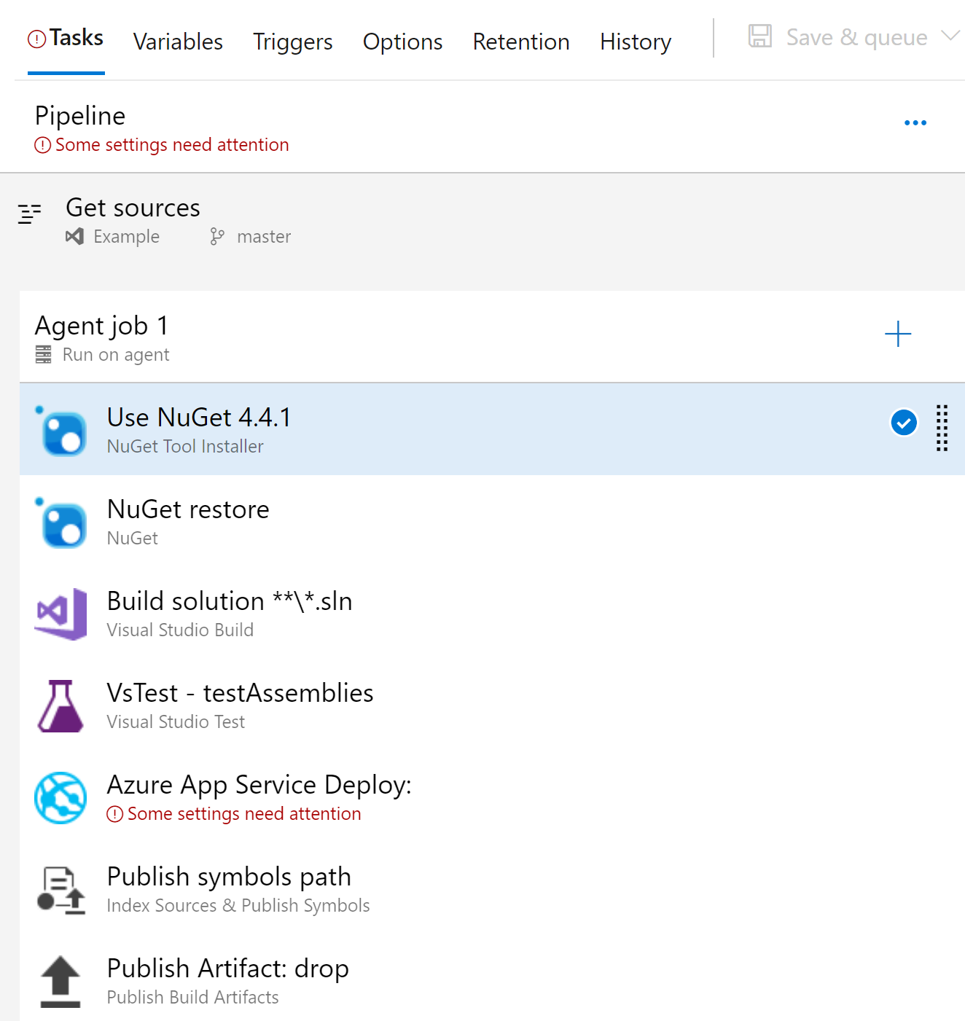
Alternatives
CI server
No local builds
Difficult to “get right”
Vendor lock-in
Difficult to debug
Often not in source control

Slide 10
What is Cake?
A build automation system
Write your build scripts in C#
Statically typed. Compiled.
Runs on .NET Core (net7.0, net6.0) and .NET Framework
Powered by Roslyn

Slide 11


What is Cake?
Open Source
MIT licensed
Available on GitHub https://github.com/cake-build/cake
Part of the .NET Foundation
Project guidance and mentoring
IP and legal

Slide 12




Some Notable users
Microsoft & GitHub
Xamarin
Octopus Deploy Big sponsor of Cake! 🥰 They’re awesome, check them out!
MAUI, Omnisharp, Azure DotNetty, NUnit, NSubstitute, Polly, SQL Tool Service, MongoDB.NET, SkiaSharp, NHibernate, Octokit, Chocolatey GUI, BenchmarkDotNet, GitTools, Bitwarden, Microsoft AppCenter SDK, DotNetNuke and many more...

Slide 13
Some numbers
68,671,403 installs
123 releases
3964 commits
1605 Pull Requests
221 contributors
+200 external developed addins and modules

Slide 14
Why use cake?
It’s C#
Statically typed, Compiled
Supports a lot of third-party tools and scenarios out-of-the-box.
Unit test frameworks, build tools, ci servers, package managers, deploy systems, install systems, code coverage etc. etc.
Everything you can do with C#, you can do in Cake!

Slide 15








Cross platform
Windows
Linux
MacOS
Docker

Slide 16
Cross framework
.NET Core
netcoreapp3.1, net5.0, net6.0, net7.0
.NET Framework
net48, net481

Slide 17
Cross environment
AppVeyor
Bamboo
BitBucket Pipelines
Bitrise
Continua CI
GitLab CI
Go CD
Jenkins
MyGet
TeamCity
TFS / Azure DevOps
Travis CI
DEVELOPER MACHINE

Slide 18
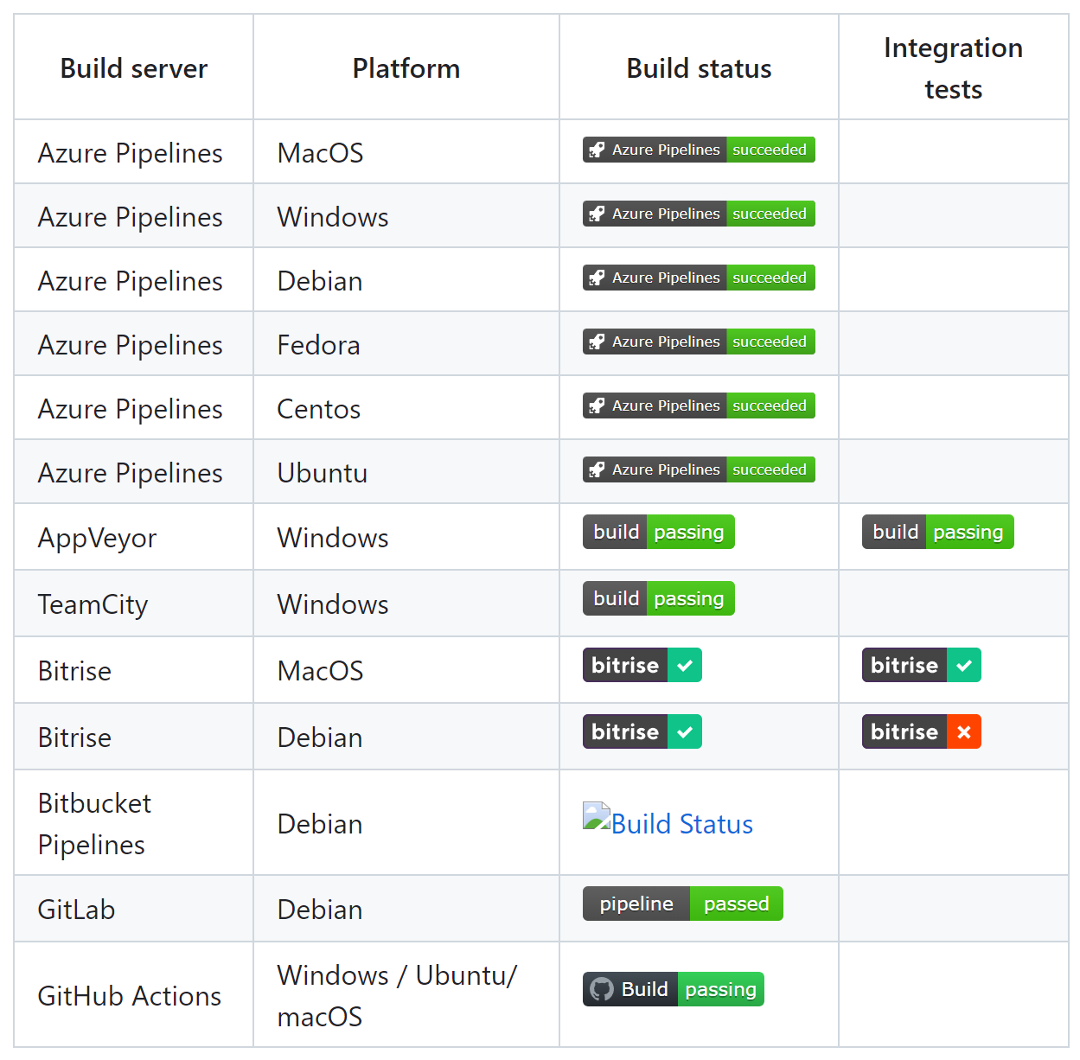
Building Cake with cake
Built-in support for 12 different CI servers. (we build and test Cake on 7 CI servers and 6 operating systems to ensure cross platform fidelity)

Slide 19
Why use cake?
Works the same locally and on build servers
Abstracts differences like the file system on different platforms
Also contains test utilities like a virtual file system to unit test addins, modules and even Cake scripts.
Build scripts versioned with source code

Slide 20
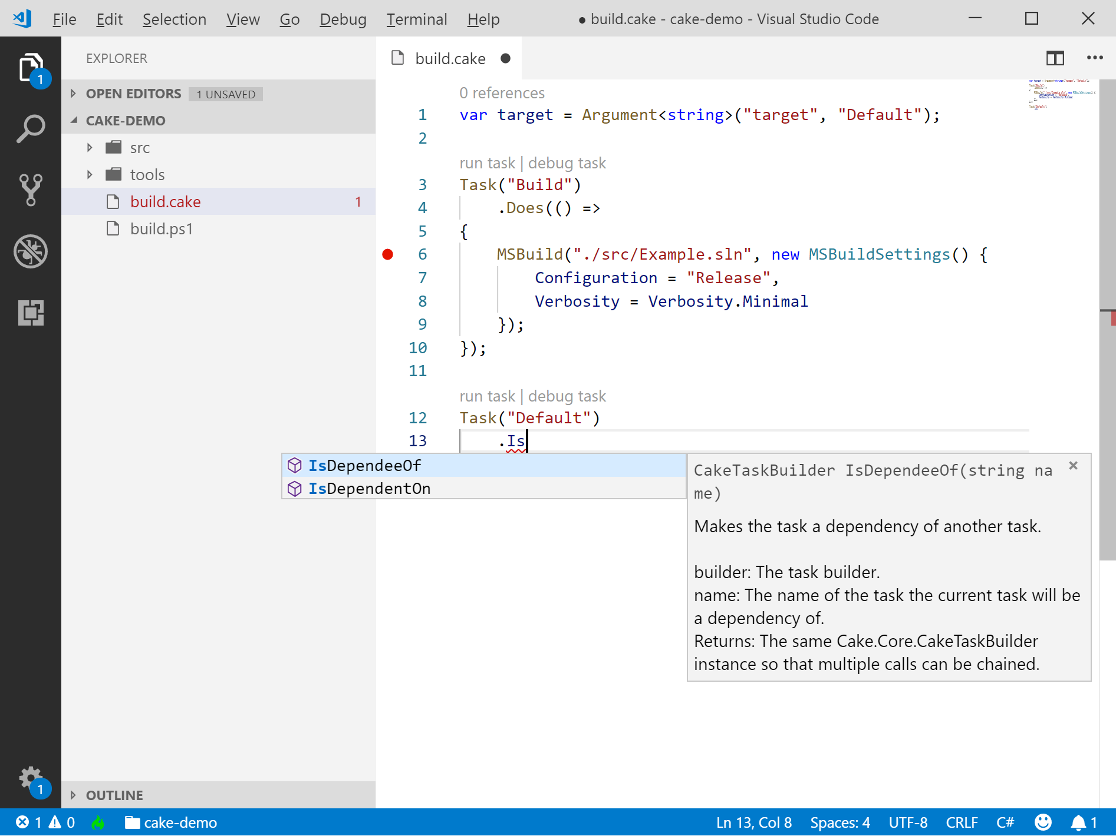
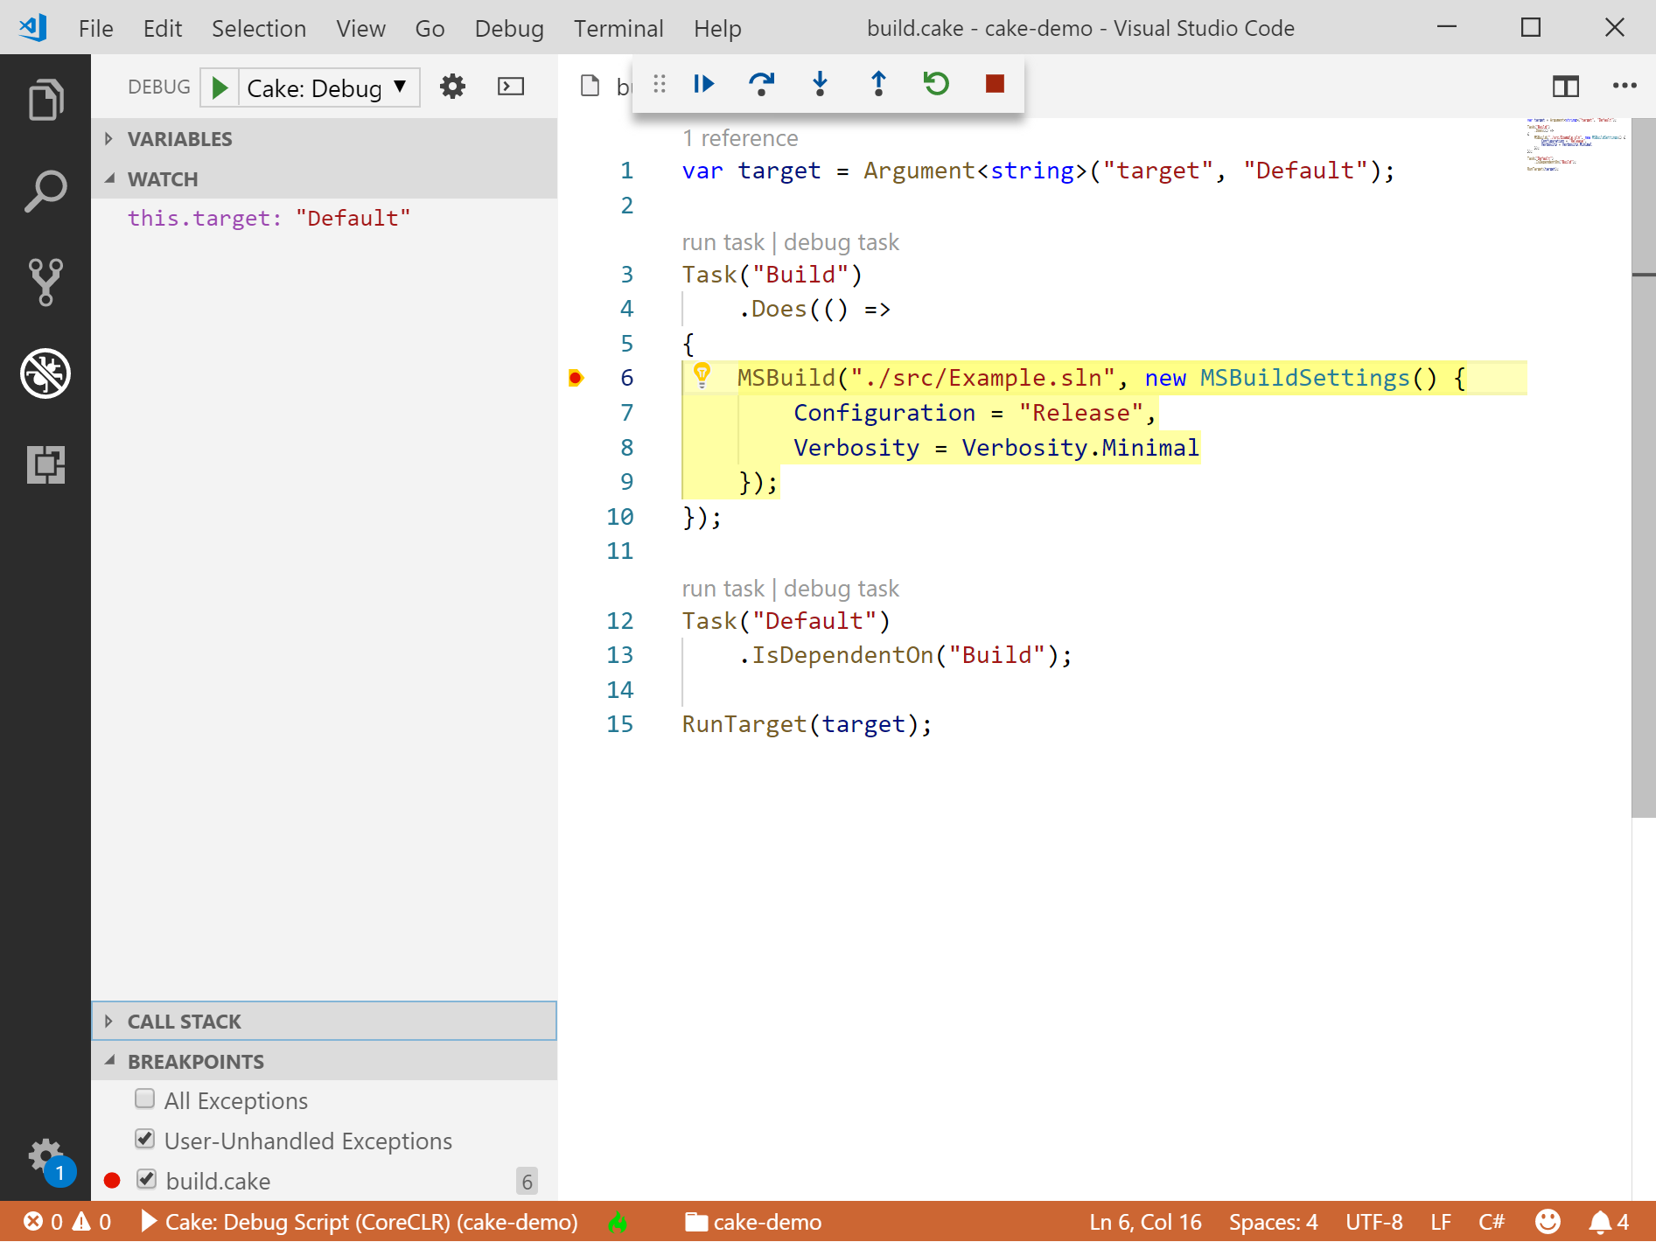
VS Code integration

Slide 21
A healthy community
Has a GREAT community!
Easy and fast to get help
Someone else have probably already encountered your problem

Slide 22
Philosophy
Increase team productivity
Decrease complexity of development and CI/CD
Build scripts and configurations in repository
No binaries or sensitive information in repository

Slide 23
Philosophy
Non-intrusive
Doesn’t affect the way you or your team works
Always behaves the same way
Regardless of operating system
Regardless of environment
Regardless of build server
Notes:
It always behaves the same, but can be configured to behave differently depending on environment. “Oh, we’re not on Azure DevOps, don’t run deploy task”

Slide 24
Philosophy
Convention based…
No surprises along the way
…but also configurable
Provide your own configuration or override defaults
Implement your own tools
Replace internal parts you don’t like

Slide 25
SO HOW DOES IT WORK?
Cake file
Normally (by convention) called build.cake
Build script logic goes here
Runner
A dotnet tool that compiles and builds the script
Notes:
Also: Docker, Dotnet tool, Chocolatey, Homebrew

Slide 26
SO HOW DOES IT WORK?
Inputs
Environment variables
Configuration file (cake.config)
Command line arguments

Slide 27
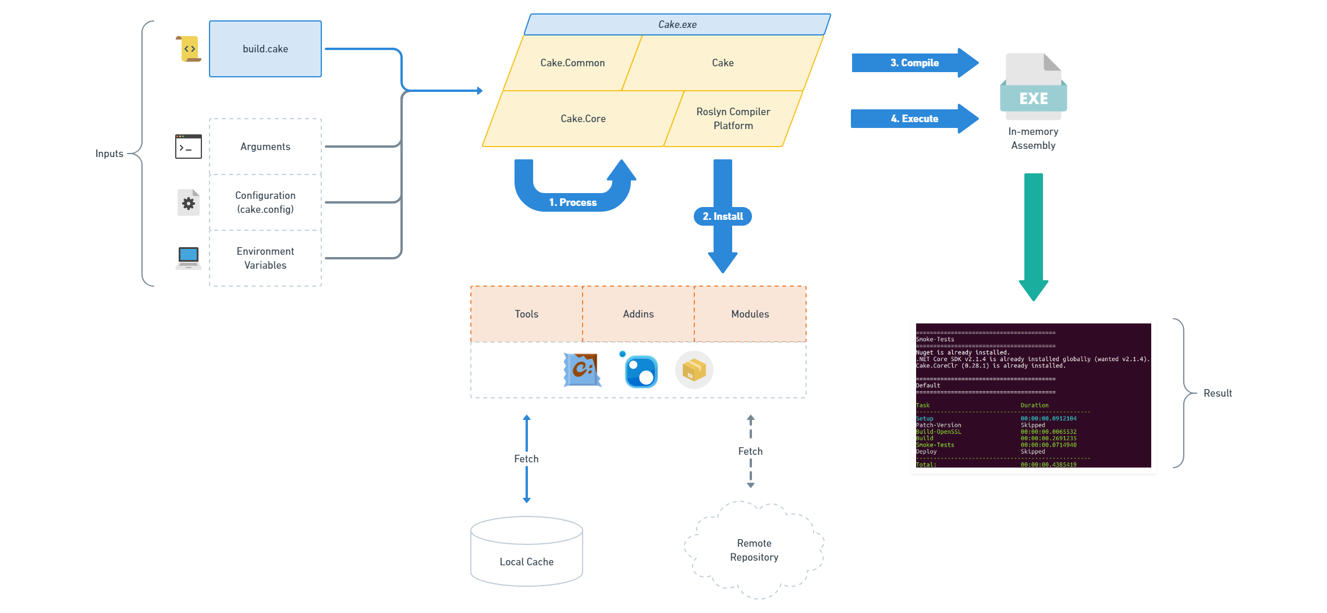
So how does it work?

Slide 28
Extensibility
Script files
Addins
Tools
Modules
Allows you to replace anything in Cake

Slide 29
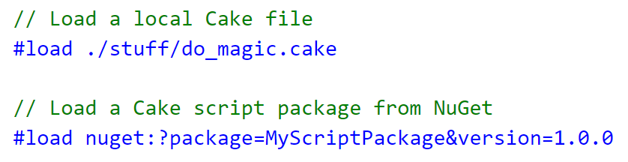
Script files

Slide 30
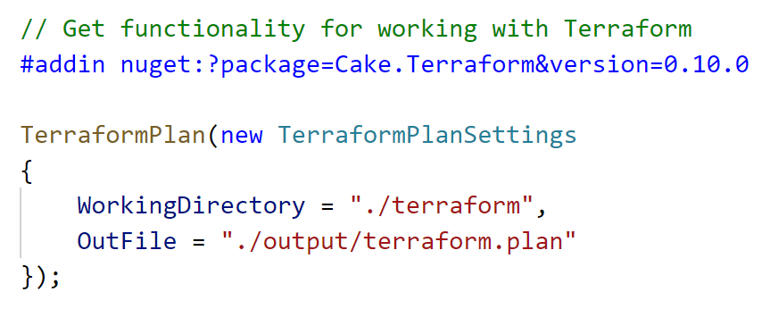
Addins

Slide 31
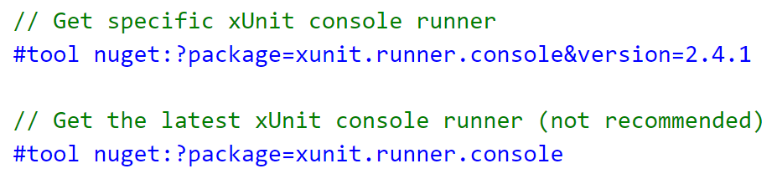
Tools

Slide 32
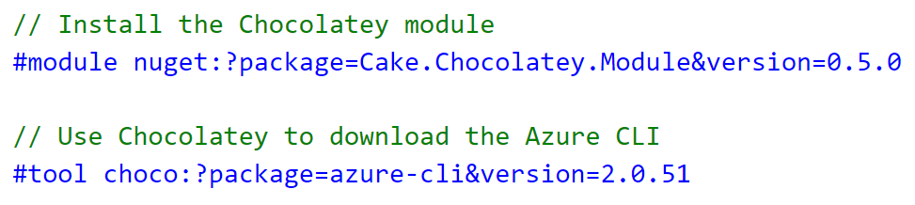
Modules

Slide 33
PACKAGE PROVIDERS
Use the pre-processor directives to tell Cake how to use something
provider:[//authority]?package=myapp&version=1.1
Easy to implement your own provider
activesolution://?package=foo&prerelease
NuGet and dotnet tool provider is built in, but others are available as external modules such as npm, apt etc

Slide 34
demo
Clean
Calculate
Version
Build
Static Analysis
Build Server
Default
Unit Tests
Packaging
Deploy

Slide 35
Getting help
GitHub
https://github.com/cake-build/cake/issues
GitHub Discussions
https://github.com/orgs/cake-build/discussions
Documentation
https://cakebuild.net
StackOverflow
Use tag cake-build
Notes:
Tons of information at Cake’s homepage.

Slide 36
Want to Contribute?
Code
Find an open issue
Get buy-in to work on it
Submit a pull request
Push early
Found a bug?
We would love hearing about it!

Slide 37
Want to Contribute?
Documentation
Fixing typos
Code samples
Documentation
Answer questions
Gitter
StackOverflow
Issues

Slide 38
Questions?

Slide 39
Thank you!

